Slide 1
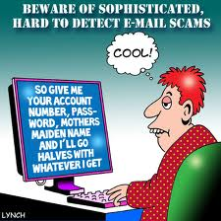
Lecture 10 CYBER SECURITY, Part II Malware and Scams

Slide 2
A Quick Review of the basics!

Slide 3
The Security Pillars
Authentication
Authorization
Privacy
Information Integrity
Non Repudiation
Availability

Slide 4
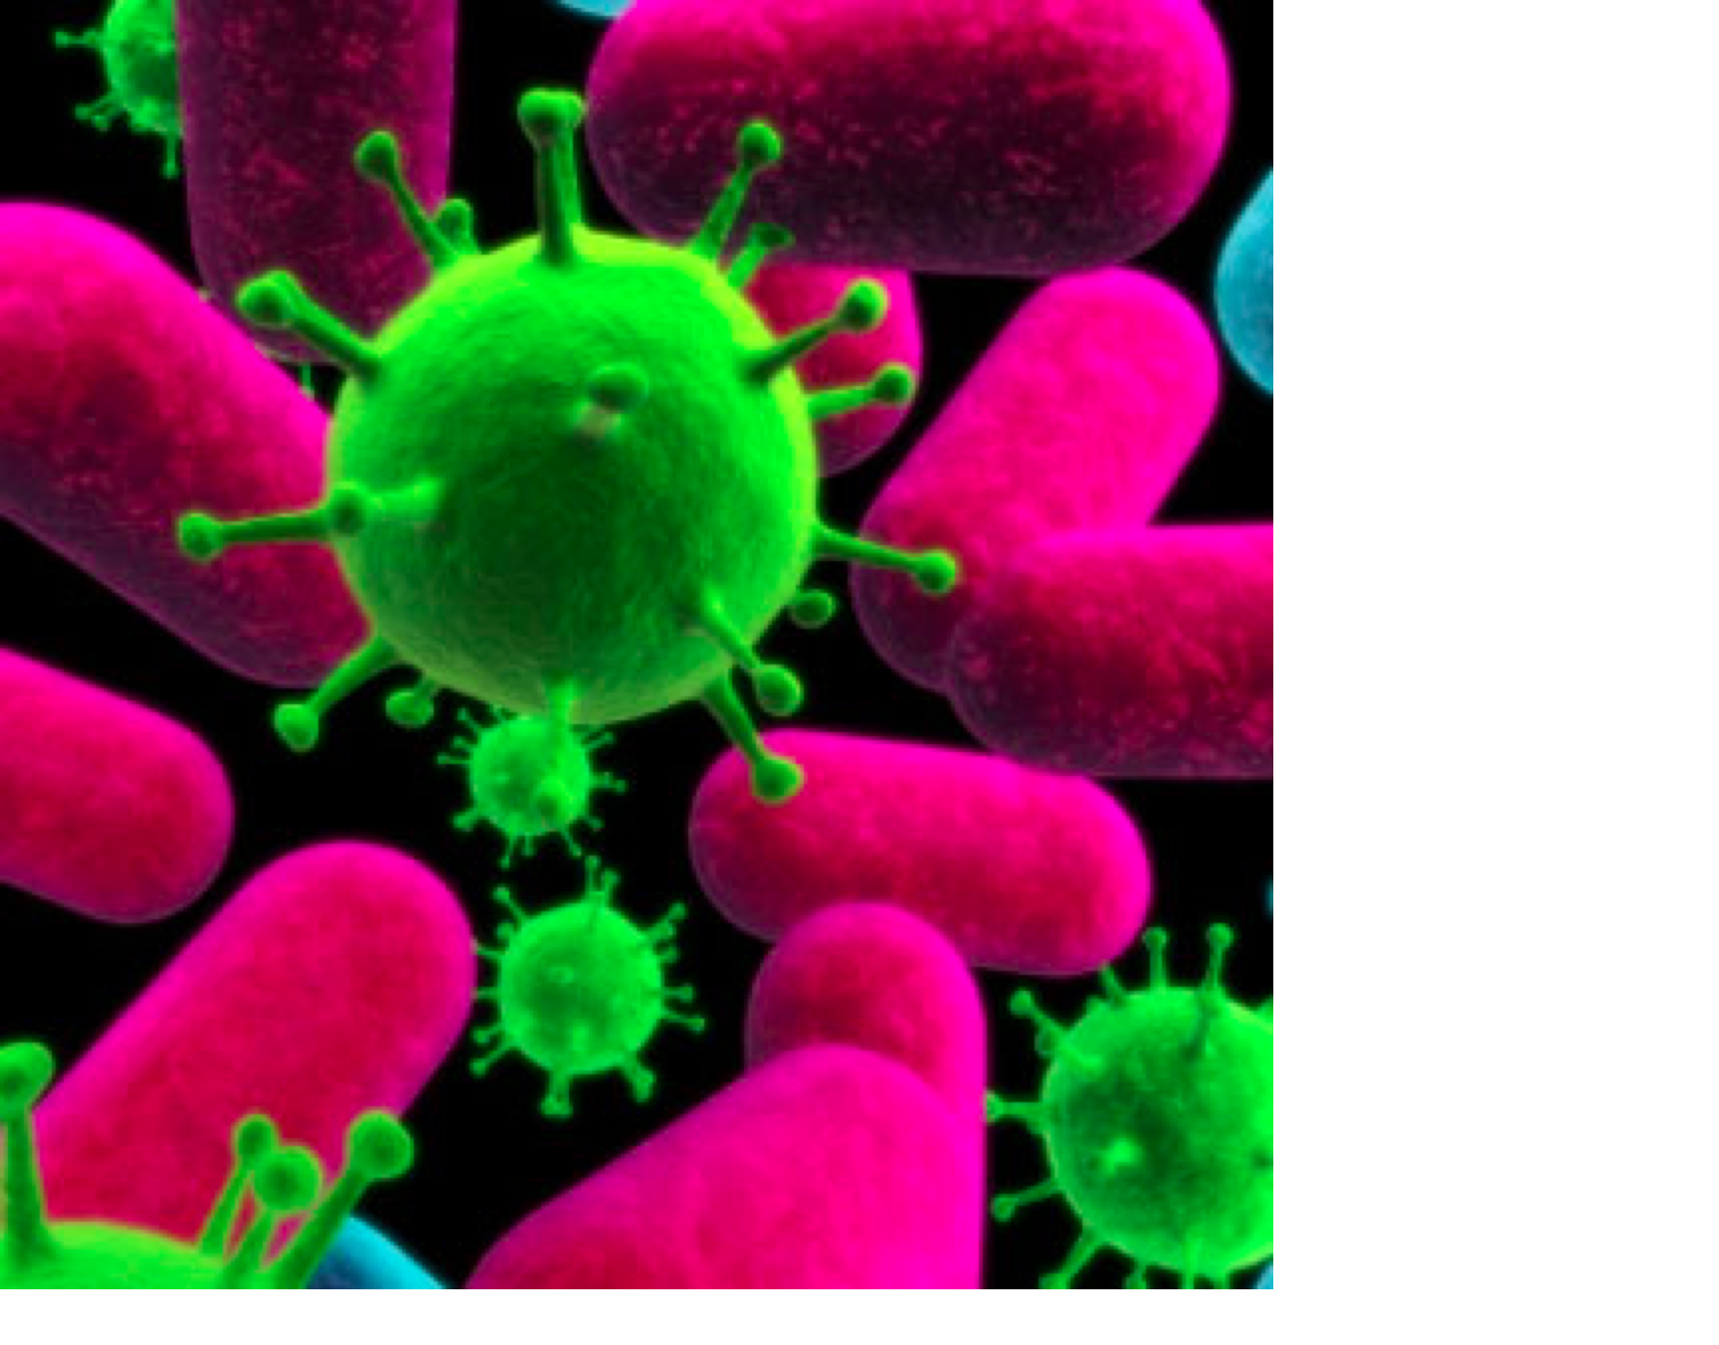
Viruses!!

Slide 5
Viruses, Worms, Trojan Horses and Spybots aka, Malware
Primarily attack on Authentication,Data Integrity, System Availability and Privacy

Slide 6
Computer Viruses
In the early 1980s, Fred Cohen did extensive theoretical research at USC, as well as setting up and performing numerous practical experiments, regarding viral type programs.
Dr. Cohen's definition of a computer virus as "a program that can 'infect' other programs by modifying them to include a ... version of itself" is generally accepted as a standard.
Aka….a illicit program hidden inside of a legitimate program that propagates through various computer and network media
Cohen created “research viruses” as part of his thesis
Today we are concerned with viruses “in the wild”

Slide 7
Viruses
Malicious software code that is usually embedded in executable programs or documents
File Infector viruses can sit in a systems memory and attach themselves to any programs that the user opens
Some viruses actually create new copies of existing programs that contain malicious code and substitute them for the original
A common technique is to infect Word documents that may then be emailed to other systems
Famous Viruses in the past were called Chernobyl, Career of Evil, Concept, Non-Petya
The worst viruses destroy the file directory or the data on your Disk!

Slide 8
How do they propagate?
Early viruses spread when people exchanged floppy disks that contained programs or data with other users and inserted them into their machines (relatively slow propagation)
Today, with the speed and global reach of the internet, viruses can spread many times faster attached to emails, and file downloads such as mp3s, images and video files
(very fast propagation and attack at a distance)

Slide 9
Types of Viruses
File Infector Viruses
Some of the oldest types
Looks like an executable file (.exe, .com, .bin, .sys)
Hides in system memory and embeds itself in applications that the user opens
Capable of infecting multiple application files
Some Infector viruses make a copy of the real application and hide themselves inside the copy. When the user clicks on the file name, the copy runs, not the original.
Macro Viruses
Hide in the popular macro commands that are popular in windows applications
These viruses infect any documents that the application opens (Word, Excel, Access, etc.)

Slide 10
Types of Viruses
Boot Sector Viruses
These viruses infect the boot track of the disk drive when the machine is booted up
By altering the boot drive, the virus can render the machine inoperable
Michelangelo was a famous boot sector virus that launches on computers on March 6th and puts the infected machines out of service
On March 6, 1992 there was almost hysteria about the effect that this virus would have on all the PCs installed worldwide

Slide 11
Worms
Responsible for today’s most widespread attacks and sometimes confused with Viruses
Unlike viruses, worms are designed to self replicate and automatically spread themselves from system to system using the network connections
Worms usually use email as their carrier method since email is such a popular application
Some worms mail themselves to everyone listed in your address book as an efficient replication mechanism
The Anna-Kournikova.jpg.vbs worm did over $80 million worth of damage because people couldn’t resist the temptation of seeing a revealing photo of her

Slide 12
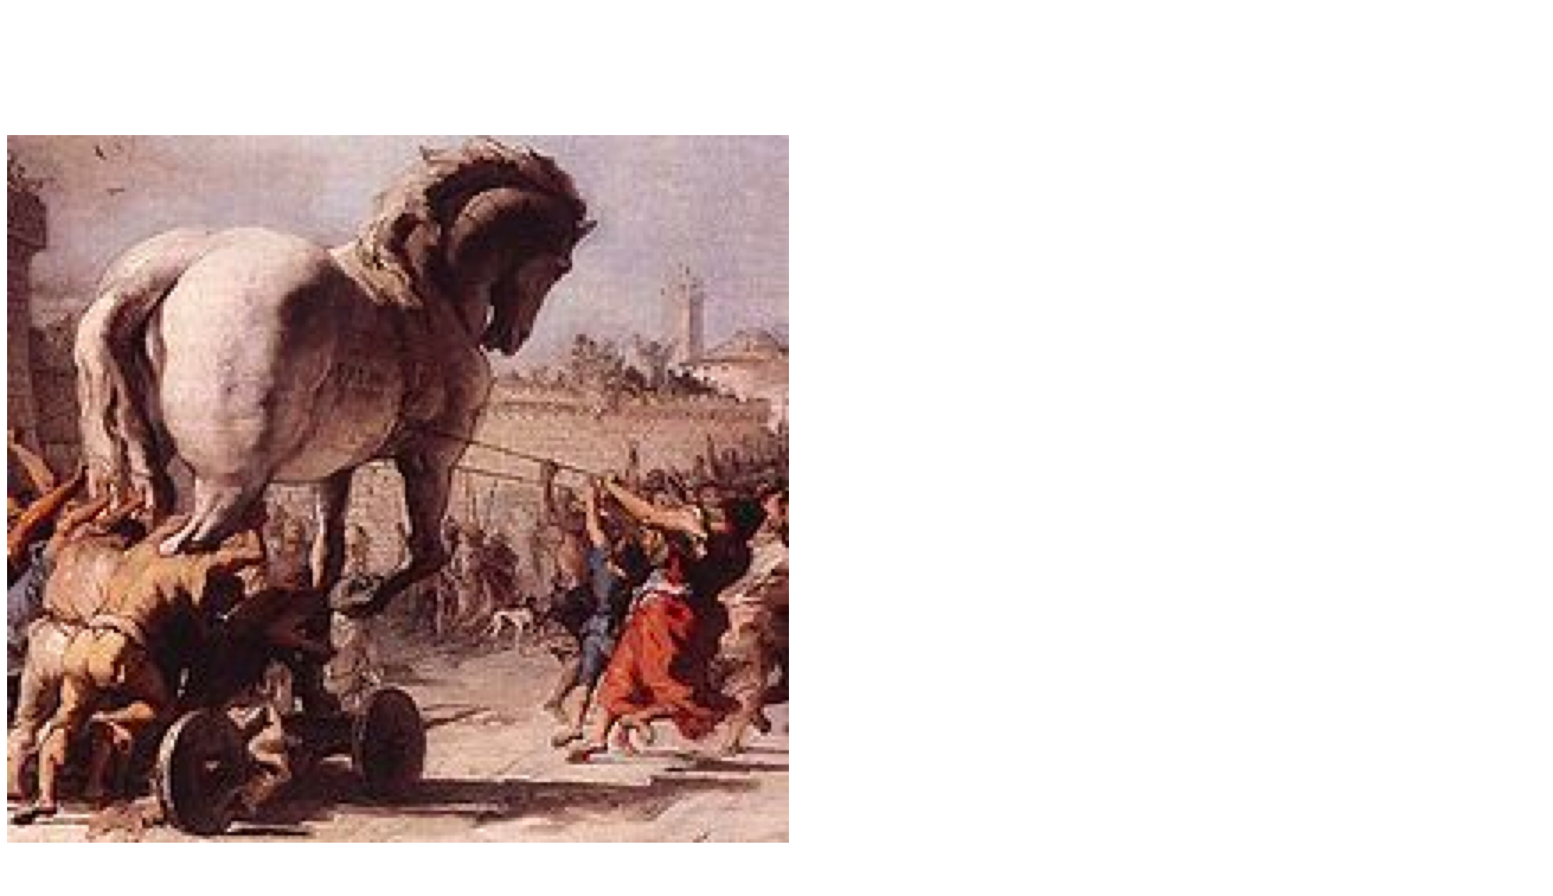
The Trojan Horse

Slide 13
Trojans
Modeled after the ancient technique of hiding a threat inside of a seemingly benign package
Trojans are usually attached to emails and contain a program that performs nasty stuff on your computer
When the user opens the email, the system resets and when it boots up, the Trojan program does its thing very secretly
Trojans can open up backdoor communications on your system which allows someone to actually see what you are typing on the keyboard (Usernames, Passwords, CC#s, Phone numbers, SS#s)!!!!!!!
Trojans can also allow someone to effectively hijack your computer and use it control everything that your machine does without you knowing it (Zombies!)

Slide 14
In Summary
A wide variety of threats
Viruses, Worms and Trojans are sometimes combined in order to confuse the detection and removal techniques
The attacks continue and get more sophisticated all the time.

Slide 15
How to attempt to protect yourself from Malware
Install Viruses protection software
Subscribe to the update Service and have the updates installed automatically on your machine
Perform a complete Virus scan of your machine at least once a week
Automatically while you are asleep!
Do not put flash memory cards from unknown parties into your machine
Only accept software downloads from reputable companies (almost 10% of all the files on popular file sharing sites are in fact Malware)
Install and run Spybot Search and Destroy regularly
Don’t open any emails promising racy photos or videos of Anna Kournikova, Pamela Anderson, Paris Hilton or Ben Affleck, George Clooney or Brad Pitt! Or anyone else for that matter….

Slide 16
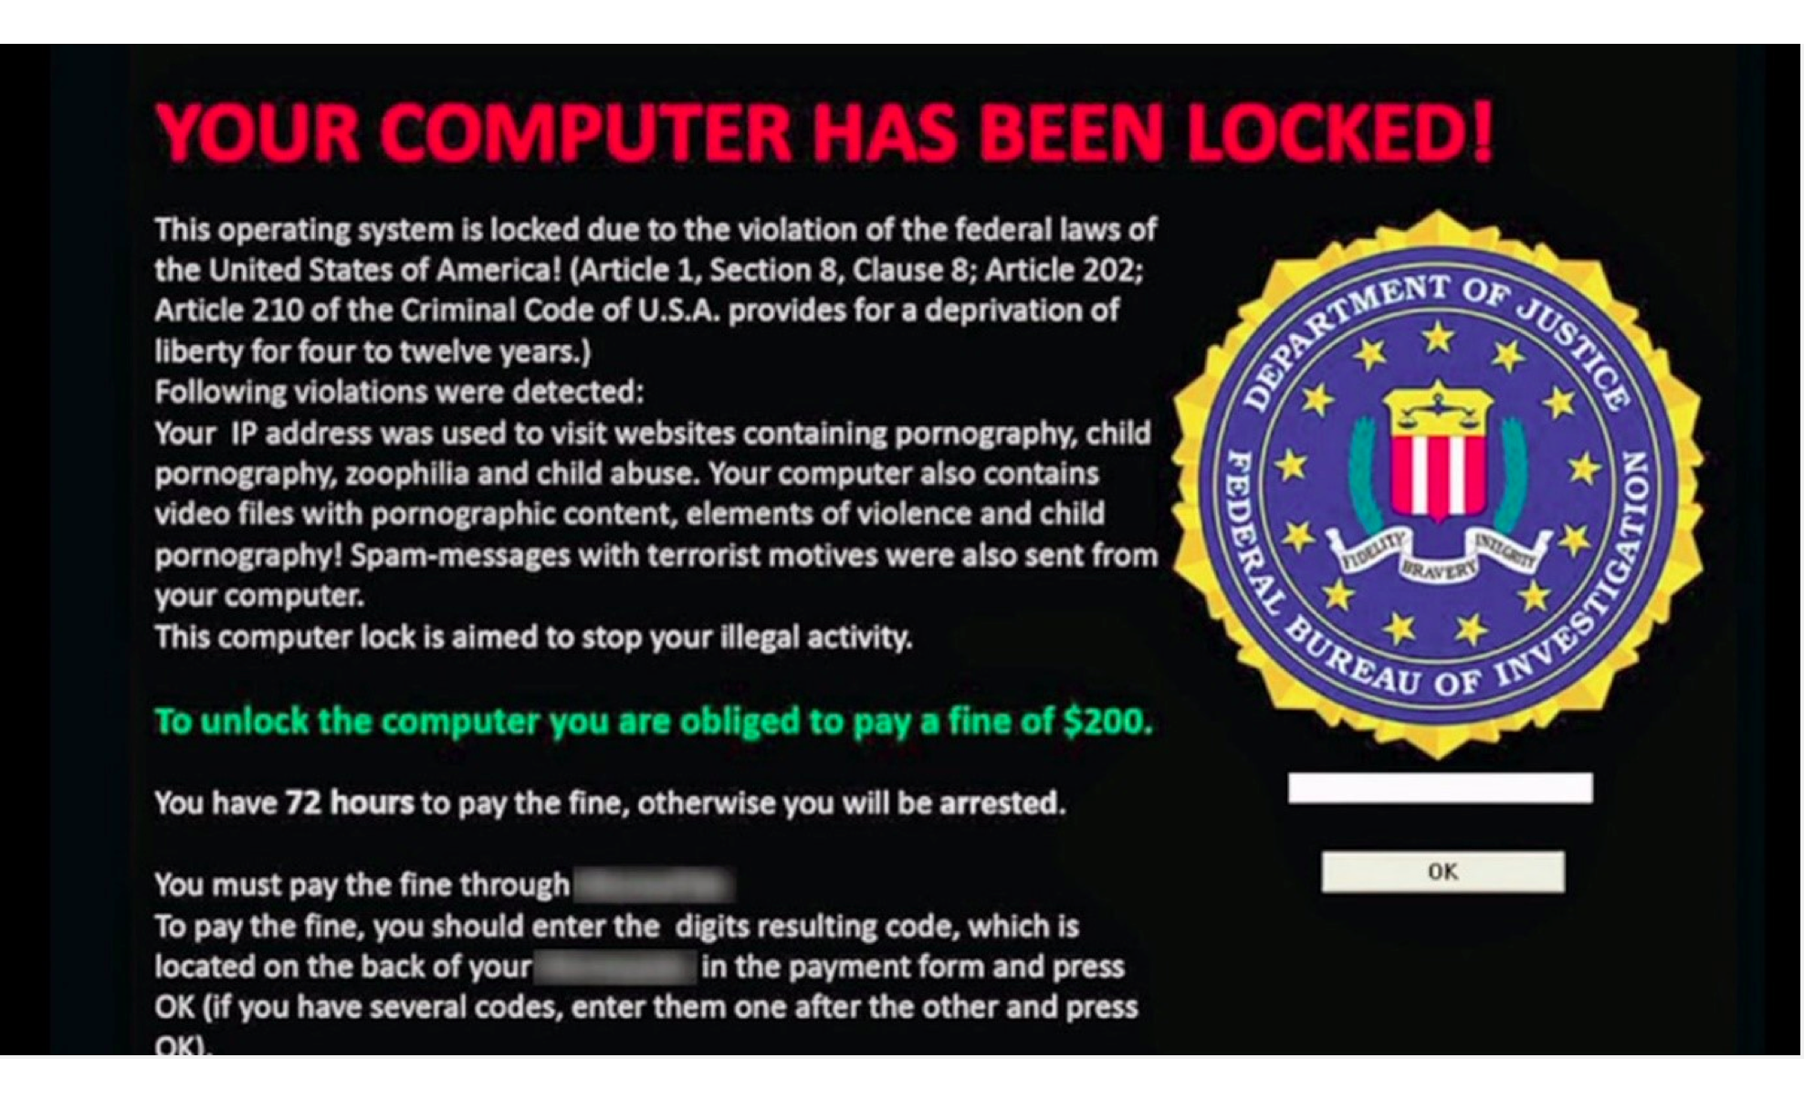
RansomWare!
Ransomware is a type of malware which restricts access to the computer system that it infects, and demands a ransom paid to the creator(s) of the malware in order for the restriction to be removed.

Slide 17
Beware of Bogus Virus Protection! (RansomWare)
The user gets a very visible warning about infections on their PC from what appears to be a legitimate source (Microsoft, etc)
They are instructed to click on a button and download software to protect themselves.
By doing so they download and install a program that incessantly pops up on their screen instructing them to pay for a viral antidote which disrupts everything else they are trying to do
They then have to go to a website and pay to remove the annoying software that they mistakenly downloaded in the first place!
VERRRRY ANNOYING!!!! and costly

Slide 18
CryptoWall and CryptoLocker
A file-encrypting ransomware program called CryptoWall infected over 600,000 computer systems and held 5 billion files hostage, earning its creators more than $1 million, researchers found.
CryptoLocker, another ransomware program that infected over half a million systems over 6 months, earned its perpetrators an estimated $3 Million!
Payment is always required using Bitcoin or another untraceable cyber currency

Slide 19
More Threats and Scams
Nigerian Letters
Phishing
Pharming

Slide 20
Nigerian Letters
Also known as “Advance Fee Fraud”
Been successfully run since the 1980’s over mail and over the Internet
Convinces the target that they will get a huge commission for helping free up money held in an offshore bank account.
Target is solicitied for small “fees” and their personal info to expedite the process
Of course, no money is forthcoming
Read all about them here http://home.rmci.net/alphae/419coal/

Slide 21
Nigerian Letter Example
Attention.Friend Its my pleasure to inform you that i have verify from the bank director regarding the transfer of your fund and it was good news because the requested fee was less expessive for you to afford. your consignment containing your fund($800.000.00) i have deposited it with the CAPITAL CITY BANK PLC so that your fund will be wired to your account immediately you contact the bank director with your banking details. However i went to CAPITAL CITY BANK PLC to discuss this with the bank director as its has not been delivered to you However he told me that your fund can be transfered to you via a direct wire transfer(KTT) into your account.He told me to instruct you to contact the bank to apply for a direct wire transfer into your account to avoid loosing your fund due to delay. Therefore you can contact the bank with below information, send to them your banking information. CAPITAL CITY BANK PLC OF BENIN REPUBLIC 20/22 HOSPITAL ROUTE COTONOU BENIN REPUBLIC

Slide 22
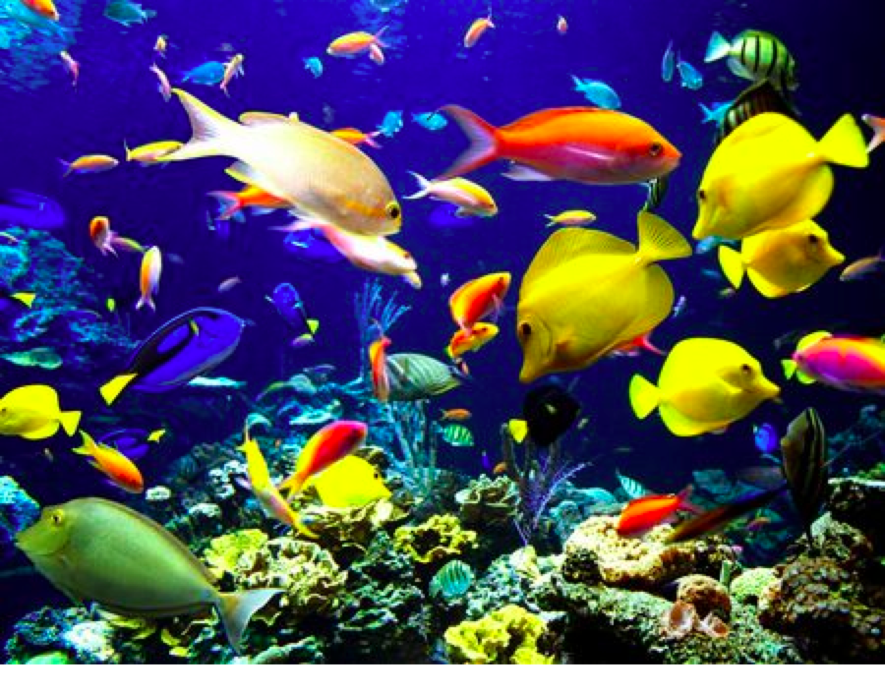
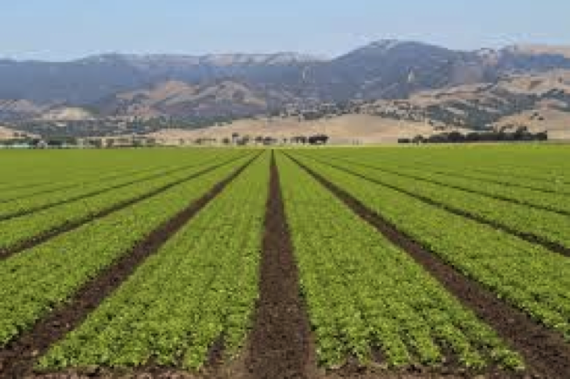
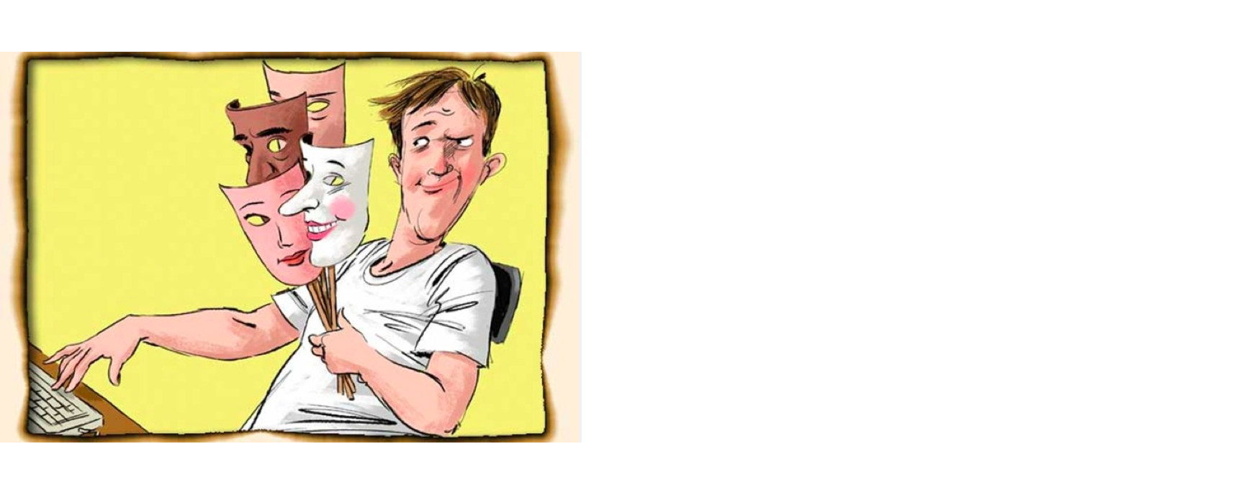
Phising and Pharming
Who Am I ????

Slide 23
Phishing
Phishing is the criminally fraudulent process of attempting to acquire sensitive information such as usernames, passwords and credit card details by masquerading as a trustworthy entity in an electronic transaction.
Phishing is an example of social engineering techniques used to fool users and exploits the poor usability of current web security technologies.
Phishing alludes to baits used to "catch" financial information and passwords.

Slide 24
Pharming
Pharming is a hacker’s attack aiming to redirect a website’s traffic to another, bogus website
Pharming can be conducted either by changing the host’s file on a victim’s computer or by exploitation of a vulnerability in DNS server software.
Antivirus software and spyware removal software cannot protect against pharming.
Pharming is also known as Page Hijacking

Slide 25
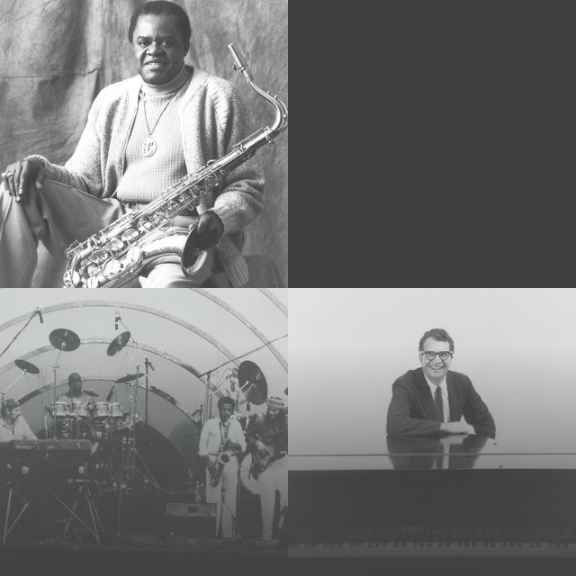
Phishing Video
http://www.youtube.com/watch?v=Y4mnIwtIWB4&feature=fvwrel

Slide 26
These days, Phishing, Pharming and Spoofing are often all combined in the same attempt to compromise someone’s personal information

Slide 27
Secure Socket Layer Demo
www.bofa.com

Slide 28
Cyber Warfare!

Slide 29
Stuxnet --- Who done it ?????
Stuxnet is a virus that is widely believed to have been developed by the U.S. and Israeil intelligence communities. It’s purpose was to infiltrate programmable control systems used in the process control industries. In particular, this worm was targeted at the controllers that operate the centrifuges used in Iran to process uranium, a key component in the quest for nuclear weapons, or reactors.
Stuxnet Video:
http://vimeo.com/25118844

Slide 30
And now, Wiki Leaks and Russian Hacks!!
2016 hacks on the DNC mail servers have been blamed by U.S. security experts on state supported Russian hackers who were trying to influence the U.S. Presidential election!
And so it goes…...

Slide 31
NotPetya Denial of Service attack 2017
Originally targeted at Ukraine by Russian government hackers, the NotPetya virus also found its way into Western European corporate computers that were located in Kiev.
Maersk Global Shipping, that provides almost 20% of all container shipping worldwide saw all its 40,000 laptops and desktops deployed around the world become corrupted and non functional within hours
All Maersk cargo was frozen in place since the routing information for each container could not be accessed.
This attack brought Maersk to its knees for several weeks and required them to re-image all 40,000 computers in order to bring its network back up and resume operations.
Several other global firms were affected including Merck Pharma.
Cost to Maersk: Over $400M….Cost to Merck: Over $800M

Slide 32
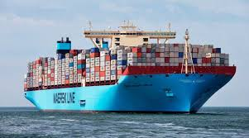
Maersk container ship with over 1000 containers on board
Read all about it here:
https://www.wired.com/story/notpetya-cyberattack-ukraine-russia-code-crashed-the-world/

Slide 33
SolarWinds Attack -- 2020
Russian hackers compromised software updates that were sent by SolarWinds, a leading supplier of network management software, to its customers around the globe.
SolarWinds stated that its customers included 425 of the US Fortune 500, the top ten US telecommunications companies, the top five US accounting firms, all branches of the US Military, the Pentagon, the State Department, as well as hundreds of universities and colleges worldwide.
This attack is considered to be one of the most sophisticated Ransomware exploits to date and has affected companies around the world.
Read the details here: https://www.businessinsider.com/solarwinds-hack-explained-government-agencies-cyber-security-2020-12

Slide 34
Colonial Pipeline Attack
Cyberattack Forces a Shutdown of a Top U.S. Pipeline
The operator, Colonial Pipeline, said it had halted systems for its 5,500 miles of pipeline after being hit by a ransomware attack.
The attackers demanded $5M in Bitcoin Digital Currency
Portends future attacks aimed at critical infrastructure

Slide 35
Attack on U.S. Airports October 10, 2022 !!!
Hackers took down several U.S. airport web sites, Department of Homeland Security confirms
Pro-Russian hackers claim responsibility for knocking U.S. airport websites offline

Slide 36
Questions?

